Slide 1
DEBUGGING OF NOTE TAKING APPLICATION

Slide 2
We have a note taking application with only one route (i.e. Home Route). This Application is broken.
We need to refactor the code and try to make sure that the application works properly.

Slide 3
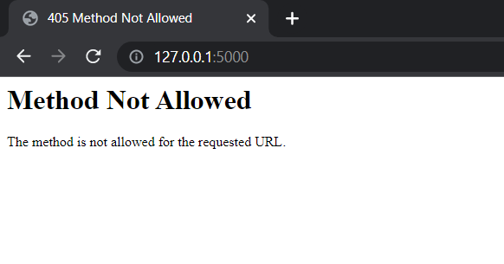
The output getting displayed before debugging the code:

Slide 4
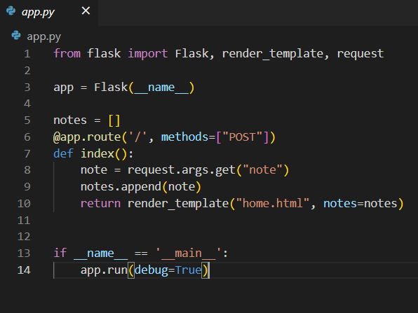
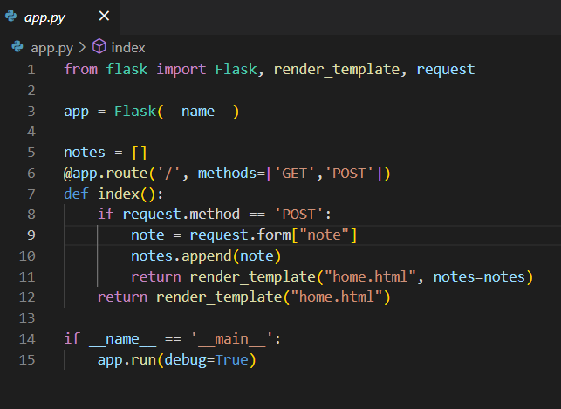
Changes Done in the backend:
I added both the ‘GET’ and ‘POST’ request to my route as I wanted the home page to be of GET request and my entered text should be secured so POST request.
Also, The method passed in the route is ‘POST’ and the request to fetch the data from frontend is called as ‘.args’ which is used for ‘GET’. So, I changed it to ‘.form’ which is used for ‘POST’.
There should be 2 return statements. One for the GET method and one for POST method and the POST method should return the entered text as output in a variable to the frontend along with the .html page.
Code Before Debugging:
Code After Debugging:

Slide 5
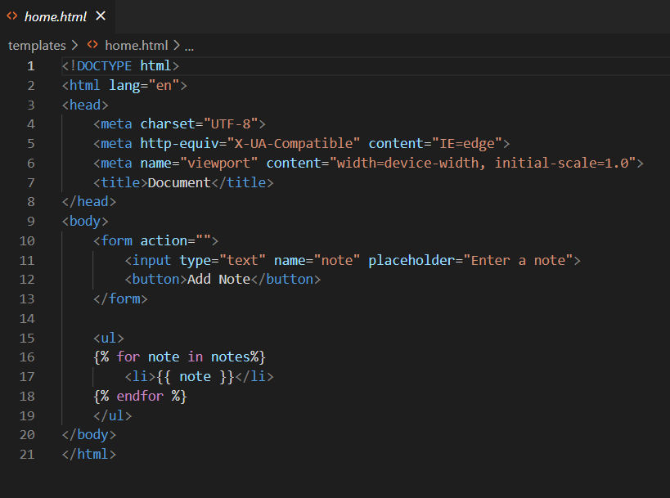
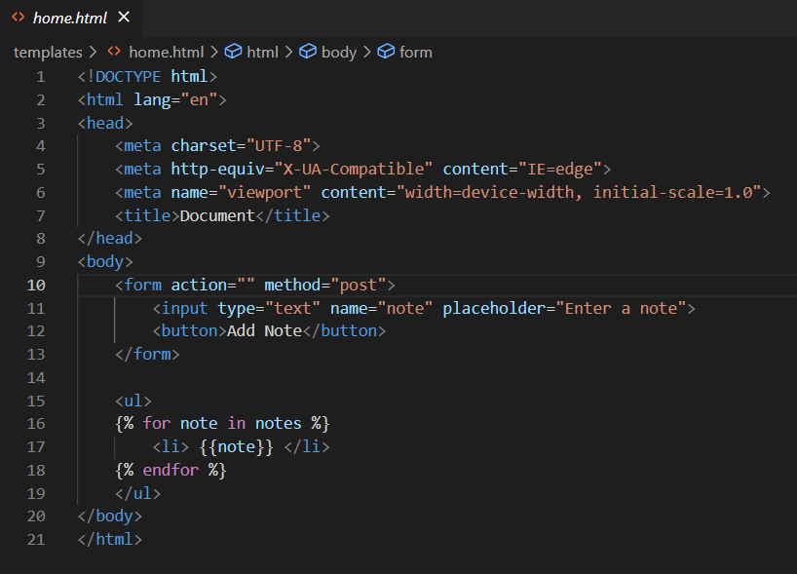
Changes Done in the frontend:
The only change done in the frontend was that we added the method type as ‘post’ next to action as we wanted the output to get displayed in post request after clicking on the Button.
Code Before Debugging:
Code After Debugging:

Slide 6
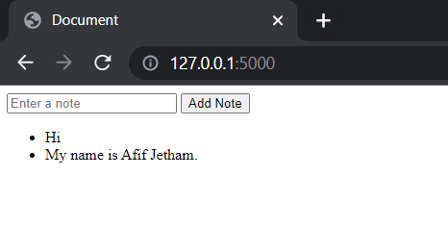
The Application Runs Successfully. Thus, the output getting displayed after debugging the code:

